Slide 1
Firms’ response to climate change and digital technologies –
insights from an international comparative study
Dr Anastasia Ri

Slide 2
Background and research question
Productivity in transition –
an international comparative analysis of the twin transition,
its enablers, and productivity implications
This 2-year project aims to explore relationships between the digital and net-zero transitions, on the one hand, and between this twin transition and firm productivity, on the other.
+other underlying conditions (previous investment, finance)
+incentive structures – which are the most supportive?
Quantitative Perspective
In partnership with the European Investment Bank (Luxembourg)
Qualitative Perspective
In partnership with Grenoble School of Management (France)

Slide 3
Background and research question
Firms’ response(s) to climate change
Climate Mitigation
strategies designed to reduce greenhouse gas (GHG) emissions may have more limited private benefits but are likely to have substantial public benefits linked to reduced climate impacts
Climate Adaptation
strategies designed to increase business resilience and ensure business continuity in the face of changes in climate related risks have benefits which are largely private.
“Even though individuals (firms) will mitigate their emissions, the incentives to do so are to be provided by governments” (Toll, 2005)
Matter of national governments in the context of international negotiations
“Incentives to adapt are already in place… need not be created by governments” (Toll, 2005)
Preconditions (access to information, knowledge, skills, financial resources) may be facilitated by governments – conducive environment (Fankhauser et al, 1999)

Slide 4
Background and research question
RQ: Do digital technologies facilitate adaption and mitigation?
i.e. do digital technologies make businesses better equipped to tackle climate change challenges, both through adaptation and mitigation strategies?
Twin net zero and digital transition is believed to be an important pathway to sustainable recovery (Bai et al. 2020; Hanelt et al. 2017).
Yet, little is known about how these two transition processes relate to each other and how organisations may leverage digital technologies and capabilities to innovate for environmental sustainability.
Crucially, empirical quantitative micro-evidence of their connection is scarce, especially in the context of SMEs (OECD, 2021).
Why adaptation too?
While there is a growing body of literature on business mitigation, the knowledge of adaptation decision-making is still very limited (Bleda & Pinkse, 2023; Clement & Rivera, 2017; Linnenluecke, Griffiths, & Winn, 2013; Peregrino de Brito, 2021).
Linnenluecke et al. (2013) highlight the lack of empirical studies on firm adaptation to climate change.
Most empirical studies focus on most exposed to climate change impacts sectors: tourism, agriculture, winery, ski resorts, energy sector (Peregrino de Brito, 2021). For firms in less exposed sectors, the decision-making process is more “ambiguous” (Bleda & Pinkse, 2023).

Slide 5
Conceptual framework
Strategy
Actions
Constraints
Incentives
Recognition of the need / opportunity
Adaptation
Capabilities
Constraints
Incentives
Recognition of the need / opportunity
Mitigation
Business environment: natural, regulatory and policy, social norms, knowledge, customers, network…
Digital innovativeness

Slide 6
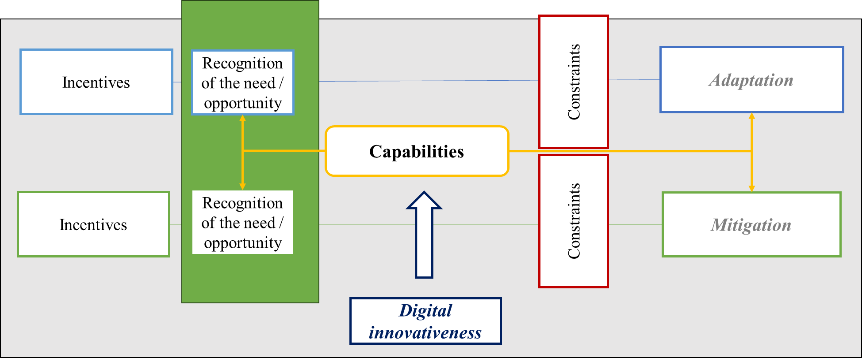
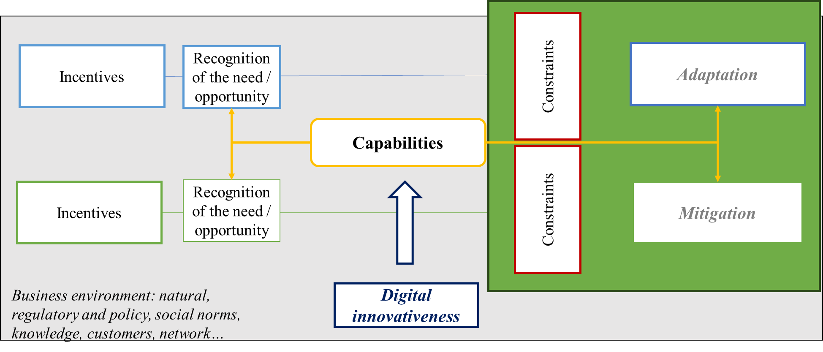
Hypothesis
Hypothesis 1. More advanced digital adopters have better ability to access and process information and hence more likely to recognise the need of climate response(s) by making strategic choice of adopting climate adaptation or climate mitigation measures, or both.
Probability of climate response(s)
Hypothesis 2.
More advanced digital adopters are more intensively engaged in climate adaptation actions
More advanced digital adopters are more intensively engaged in climate mitigation actions
Intensity of climate response(s)

Slide 7
Data overview
European Investment Bank Investment Survey, 2022-2023,
pooled cross-section ~25,000 firms across 27 EU countries and USA
Probability of climate response(s)
Intensity of climate response(s)
Type of climate response (0 to 3):
0 – No climate response;
1 – Adaptation only;
2 – Mitigation only;
3 – Both Adaptation and Mitigation
ICA - Intensity of Climate Adaptation
(0 to 3)
measured by number of CA practices adopted
ICM - Intensity of Climate Mitigation
(0 to 5)
measured by number of CM practices adopted

Slide 8
Data overview

Slide 9
Data overview
European Investment Bank Investment Survey, 2022-2023,
pooled cross-section ~25,000 firms across 27 EU countries and USA
Digital adopters’ categories (1 to 5):
1 – Digital Laggards
2 – Digital Late majority
3 – Digital Early majority
4 – Digital Early adopters
5 – Digital Innovators
Traditional
Sceptical
Deliberate
Respect
Venturesome
Laggards
16%
Late
majority
34%
Early majority
34%
Early adopters
13.5%
Innovators
2.5%
$$\overline{x}−sd$$
$$\overline{x}$$
$$\overline{x}+sd$$
$$\overline{x}+2sd$$
$$digital innovativeness$$
Digital innovativeness (0 to 8):
Constructed as a composite measure based on information for each of the 4 ‘state-of-the art for the sector’ digital technologies
0 – Firm did not adopt the technology;
1 – Adopted partially;
2 – Adopted fully

Slide 10
Data overview
Digital adopters’ categories by firm size

Slide 11
Data overview
Digital adopters’ categories by sector
In Information and Communication sector, percentage of digital innovators is over 10%

Slide 12
Data overview
Type of climate response(s) by digital adopters’ categories

Slide 13
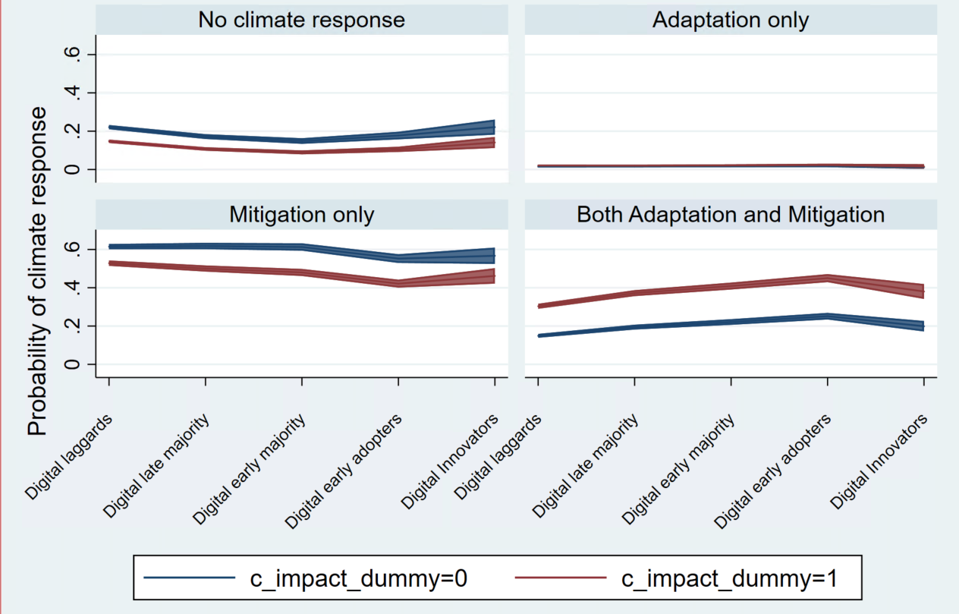
Results
Probability of climate response(s)
Probability of climate response(s) conditional on perception of climate change impact on business
Digitally more advanced firms are more likely to formulate simultaneous adaptation and mitigation response to climate change.
e.g. Digital early adopters are 12.6 percentage points more likely than digital laggards to undertake CA and CM simultaneously.
Probability of simultaneous climate response is higher for firms saying that climate changes currently have impact (minor or major) on the business.

Slide 14
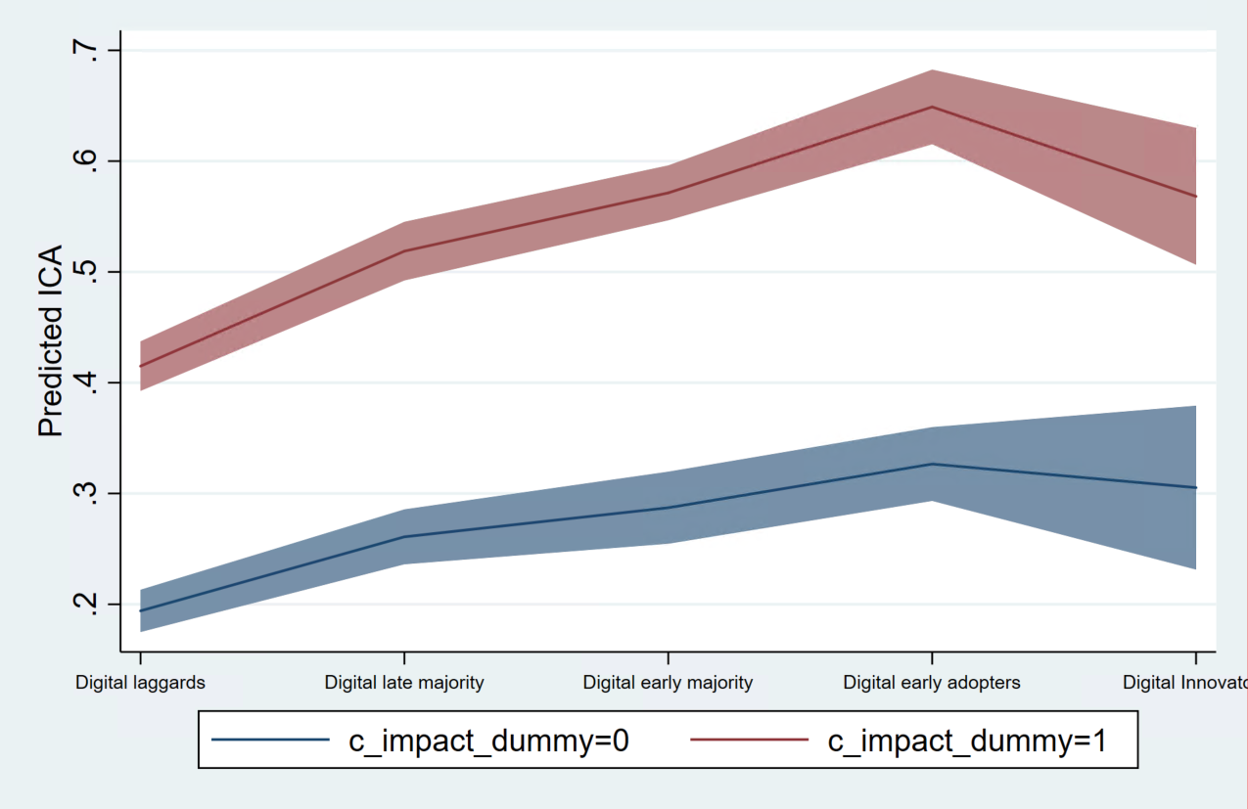
Results
Intensity of climate response(s)
Predicted intensity of climate adaptation (ICA) conditional on perception of climate change impact on business
Climate change perceptions play a moderating role: firms experiencing climate change impact on the business are more intensively engaged with CA.
Digitally more advanced firms are more intensively engaged in climate adaptation actions.
Non-linear relationship: Digital early adopters show higher ICA compared to digital innovators.

Slide 15
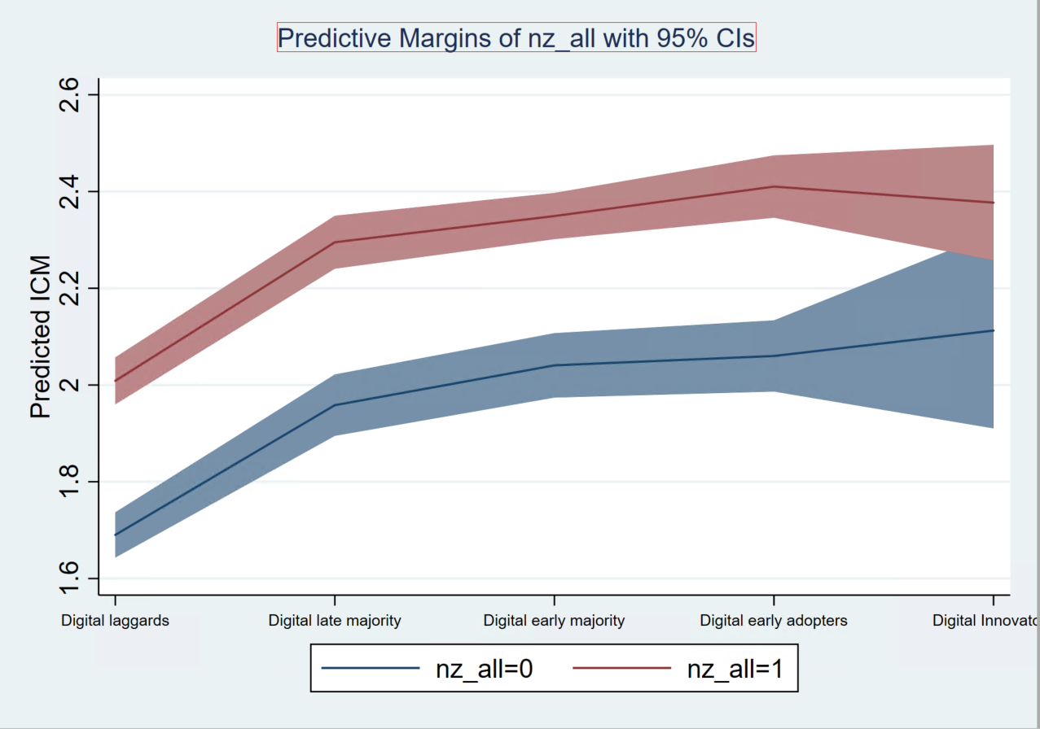
Results
Intensity of climate response(s)
Predicted intensity of climate mitigation (ICM) conditional on risk/opportunity perception of transition to stricter climate standards and regulations in the next five years
Perceptions of risk/opportunity play a moderating role: firms perceiving a risk/opportunity of green transition in the future are more intensively engaged with CM.
Digitally more advanced firms are more intensively engaged in climate mitigation actions.

Slide 16
Results
Results are robust to other specifications.
To address potential endogeneity issue, additional IV analysis was conducted. We instrument digital adopters’ categories by variables related to the performance of digital infrastructure at NUTS2 level: fixed average download and upload speed, latency, etc.
The results confirm positive relationship between the stage of digital advancement and ICA and ICM.

Slide 17
Results
Intensity of Climate Adaptation (ICA)
Intensity of climate Mitigation (ICM)
Sector
More advanced digital adopters are more intensively engaged in climate adaptation actions across all sectors, i.e. effect is rather homogeneous.
Idem.
In Manufacturing and Services, there is an increasing benefit of progressing on digital ladder on ICM, which cannot be observed in Construction and Infrastructure where first stepping from laggards to digital late majority has already substantial benefits.
Size
More advanced digital adopters are more intensively engaged in climate adaptation actions across all firm sizes with some nuances.
For micro and small businesses even a small improvement in digital passing from Digital laggards to 2nd and 3rd groups have much higher impact on ICA compared to medium and large businesses.
Idem

Slide 18
Concluding remarks
Robust evidence of Twin digital and green transition at firm level
Low uptake of adaptation measures – low resilience?: despite private benefits of climate adaptation (business continuity and resilience), the rate of uptake of CA measures is very small.
Double importance - role of digital in:
Ability to recognise the need/opportunity to develop climate response(s) leading to a climate response strategy
Ability to act on this choice by intensifying engagement
Not a substitution: digitally enabled businesses choose to do both Adaptation and Mitigation in response to climate change
Shaped by perceptions: the relationship between digital and CA and CM is also shaped by perceived business exposure and vulnerability to climate change and perception of risk/opportunity associated with transition to stricter climate standards and regulations.

Slide 19
Link to the manifesto for small business growth and productivity
Increase the adoption of digital technologies
…by increasing digital literacy and awareness
“We need more UK businesses to adopt digital technologies that can in turn improve their productivity. ERC research has shown that digital adoption is important for improving productivity in small firms. Targeted support programmes and peer networking have been shown to be helpful in raising the confidence of business leaders in terms of technology adoption. However, digital readiness is key to adoption, and creating more ‘digitally ready’ firms should be a policy focus. There are potential productivity benefits in targeting those firms that do not currently recognise the benefits of digital transformation for their businesses.”

Slide 20
Link to the manifesto for small business growth and productivity
Improve the provision of quality, actionable information on net zero
…and develop agreed standards for measuring environmental impact
“The UK’s small businesses urgently need access to information and advice to help them adopt net zero practices and measure their effectiveness. Small and medium sized businesses are estimated to account for around half of all UK business emissions, and as such they will play a crucial part in the net zero transition. ERC research has shown, however, that there is much room for improvement when it comes to the adoption of net zero practices in small firms in the UK, especially amongst the smallest firms. The evidence shows that the problem with adoption is not around intentions when it comes to sustainability – but more around bandwidth, prioritisation and capability. At present the net zero support landscape is fragmented, with only a small minority of firms receiving support. Access to trusted and actionable information is vital in supporting firms to implement sustainability practices, with government, professional and industry associations all playing potentially important roles. There are also potential advantages in designing future policy support that grasps the complementary benefits of net zero and digital adoption.”

Slide 21
Thank you
For further details please visit :
www.enterpriseresearch.ac.uk
@ERC_UK

