Slide 1
ERC Research Showcase February 22nd 2024

Slide 2
Welcome and Introduction
Mark Hart

Slide 3
Opening Remarks
Highlight 4 key areas of current research:
Trade
Climate change and digital technologies
Rural SMEs and environmental action
Workplace mental health
ERC Manifesto for small business growth and productivity
ERC Plans for 2024 and beyond

Slide 4
Business Dynamism in the UK
Business Dynamism in long-term decline since 1998 - Job Allocation Rate (JAR) falling from 35% in 1998 to 22% in 2022
400,000 more established SMEs (3 years +) since 2010 but proportion registering growth in employment falling from 20% to 13%
…. and yet, business support in England currently in a state of transition.

Slide 5
Jobs, Turnover and Productivity
Developing a new focus for small business policy in the UK
Previous research by the ERC showed that there was a very poor correlation between jobs growth, increases in revenues and productivity gains in the UK business population.
Panel study of 250k employer enterprises (2008-15) - only 5% of the firms studied managed to significantly increase turnover, jobs and productivity at the same time – some 10,000 firms!
The relationship between the growth of turnover and productivity was strong and positive, with 3 out of 4 firms that grew turnover also raising productivity.

Slide 6
Productivity Heroes
We set out to investigate those firms that are registering productivity gains (i.e., turnover per employee) and are doing so while still creating jobs.
These small businesses we call ‘Productivity Heroes’ are defined as SMEs aged 3 years and over that are growing both their revenues and headcount but their revenues at a faster rate.
The base population used to identify the number of Productivity Heroes is all surviving private sector SME employer enterprises (1-249 emps) in the UK in 2021-22 which are at least 3 years of age - i.e., not start-ups – 1.22m enterprises.

Slide 7
Productivity Heroes - Trends
So, out of a total of 453,231 firms that had increased their productivity we can see that there is a small group of SMEs (8% or 36,298 firms) aged 3 years and over within this total that are creating jobs by an average of 29% growth but growing revenue even more rapidly by an average of 196%
Year | No. of SMEs (3 years and over) | No. and % of businesses achieving productivity growth | No. and % of Productivity Heroes¹
2000-01 | 676k | 347k - 51.3% | 4.5% (15,622)
2007-08 | 825k | 449k - 54.4% | 8.8% (39,245)
2010-11 | 882k | 358k - 40.7% | 6.6% (23,740)
2018-19 | 1.13m | 557k - 49.2% | 6.7% (37,125)
2021-22 | 1.22m | 453k - 37.0% | 8.0% (36,298)

Slide 8
Productivity Heroes – what next?
Enterprise policy should place a central focus on this newly identified small group of firms to provide some evidence on how to address the UK’s long-standing productivity problem and with it the long tail of unproductive mainly small firms.
Next stage is to track their performance over time to investigate the persistence of their productivity gains over time and indeed, looking back, identify in what year the 2021-22 cohort of Productivity Heroes first met the criteria.
Engage in qualitative research to understand the drivers of these productivity gains – especially leaders’ mindset and ambition
Read more – Hart and Bonner (2024) “Productivity Puzzles, Long Tails and Productivity Heroes: developing a new focus for small business policy in the UK”, ERC Insight Paper, February 2024.

Slide 9
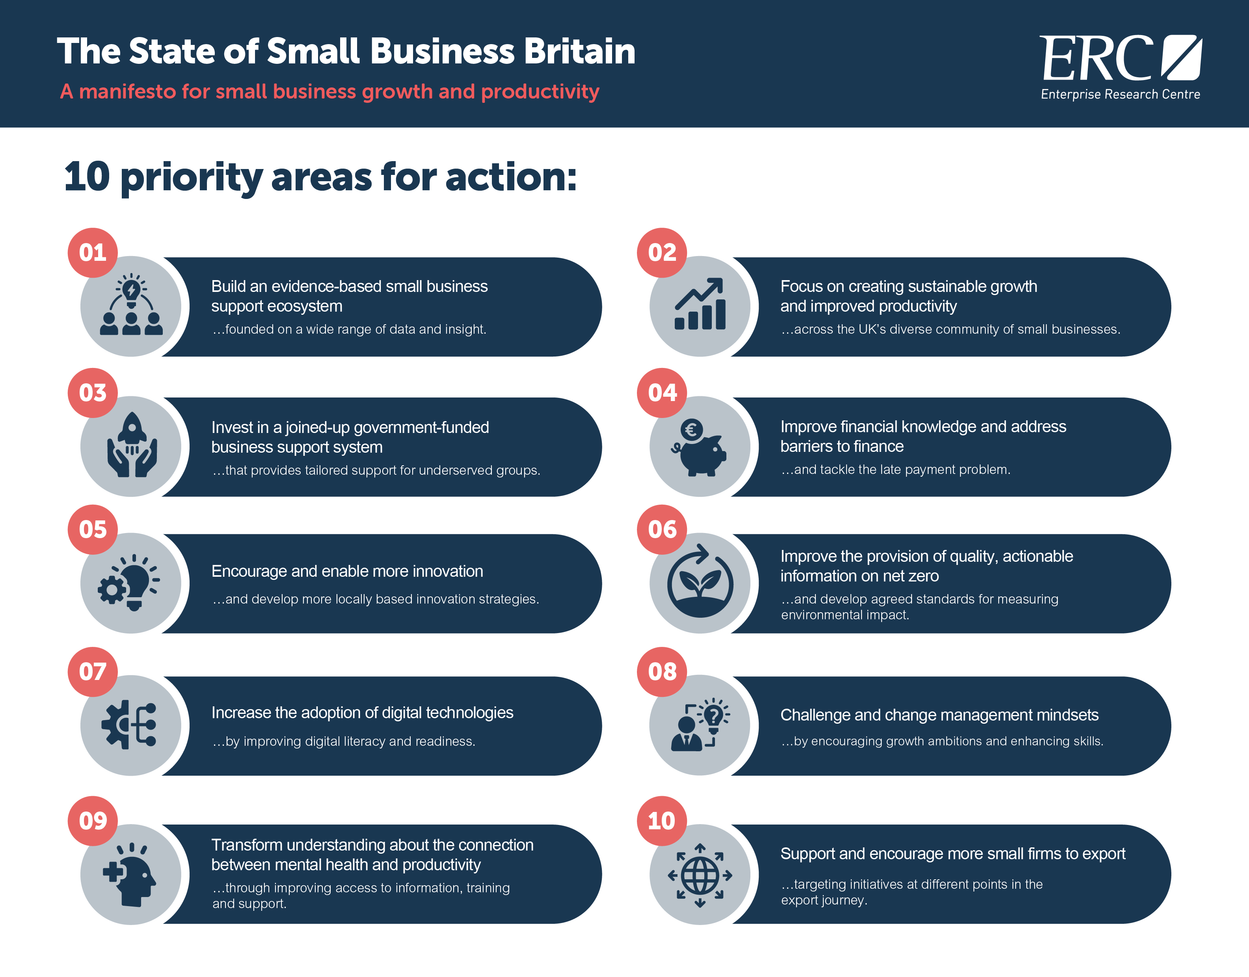

Slide 10
How do UK firms make export decisions?
Eugenie Golubova

Slide 11
Introduction
Joint ERC-DBT project which aims to identify what factors influence firms’ export decisions and what process the export decisions follow.
We focus on first export entry, exit & re-entry, persistence and export changes.
Three research elements:
Rapid literature review (screened c. 2,800 papers, analysed 135)
N=1,750 UK representative survey of exporters
N=16 interviewed firms who took first entry or re-entry decisions

Slide 12
What first entry decisions do they make?
New exporters make up 10% of the sample
Prior to exporting, nearly half had exporting as an objective in their business plan
First start exporting physical goods and physical services
Top 5 first entry countries were:
Republic of Ireland
USA
Netherlands
Germany
France
First country choice was dictated by customer enquiries or its size & ease of access
It mostly took firms less than a year to start exporting since they first considered it
Less than 10% of firms had considered other forms of entering foreign markets

Slide 13
What exit and re-entry decisions do they make?
6% are intermittent exporters
Mostly paused exports due to COVID-19 and lack of customer demand, though continued business development activities – incl. in preparation for exporting
Intermittent exporters respond to customer enquiries and maintain the status quo:
Over 8 in 10 re-entered to export the same goods or services
to all the same countries or some of the same (over 8 in 10)

Slide 14
What persistence decisions do they make?
85% of the all exporters
Persistent exporters mainly keep the status quo, though a substantial minority expand
Very few firms undertake other forms of entering foreign markets
Nearly all firms stick to their primary mode of exporting – but they use multiple export modes and cover more export markets

Slide 15
What motivates different export decisions?

Slide 16
Who makes the decisions?
The number of export decision-makers is similar across exporters
Export DMs are mainly different types of directors, heads and senior managers
Interviewees told us of equal or complementary decision-making of multiple export DMs
Other staff also contribute to export decisions, essentially by providing information

Slide 17
What are impacts of other stakeholders?
Connections vary a little, but the they have a similar level of impact on export decisions
Firms with any foreign connections report higher impact on export decisions
Advice or support relating to exporting also impacts export decisions

Slide 18
Summary
There is no single export decision, but rather multiple decisions at different times for different purposes
Customer demand is an integral part of exporting at any stage though its perceived importance changes over time and exporting patterns
At first, exporting decisions seem immutable; but over time, in persisting to export, firms change how and why they export, which we can also expect in new and intermittent exporters (if they continue)
Multiple internal and external stakeholders feed into export decision-making
There is scope for export support targeted at different exporting firms at different points in time and over time – including for persistent exporters

Slide 19
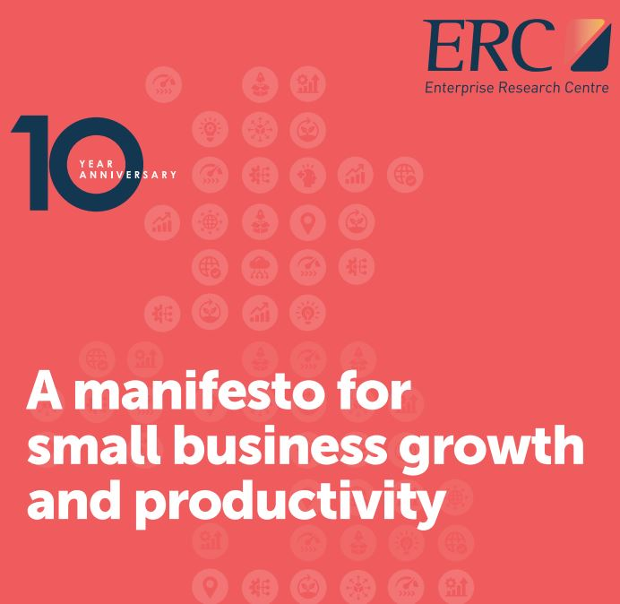
Link to the manifesto for small business growth and productivity
Support and encourage more firms to export
…targeting initiatives at different points in the export journey
“We need to encourage and support more small firms to export. The external shocks and crises of Brexit and Covid-19 have had a negative impact on export activity that has hit smaller firms the hardest, and there is an urgent need for policy action here, given the magnitude of the impacts on businesses and the wider economy. ERC research has shown that there are close links between international trade, growth ambition and innovation activity. There is a clear rationale going forward for policy action to jointly promote exporting and innovation in UK firms, targeting firms at different points in their export journey. This will involve action on a range of fronts, including government, education and business representative associations.”

Slide 20
Firms’ response to climate change and digital technologies – insights from an international comparative study
Anastasia Ri

Slide 21
Background and research question
Productivity in transition –
an international comparative analysis of the twin transition,
its enablers, and productivity implications
This 2-year project aims to explore relationships between the digital and net-zero transitions, on the one hand, and between this twin transition and firm productivity, on the other.
+other underlying conditions (previous investment, finance)
+incentive structures – which are the most supportive?
Quantitative Perspective
In partnership with the European Investment Bank (Luxembourg)
Qualitative Perspective
In partnership with Grenoble School of Management (France)

Slide 22
Background and research question
Firms’ response(s) to climate change
Climate Mitigation
strategies designed to reduce greenhouse gas (GHG) emissions may have more limited private benefits but are likely to have substantial public benefits linked to reduced climate impacts
Climate Adaptation
strategies designed to increase business resilience and ensure business continuity in the face of changes in climate related risks have benefits which are largely private.
“Even though individuals (firms) will mitigate their emissions, the incentives to do so are to be provided by governments” (Toll, 2005)
Matter of national governments in the context of international negotiations
“Incentives to adapt are already in place… need not be created by governments” (Toll, 2005)
Preconditions (access to information, knowledge, skills, financial resources) may be facilitated by governments – conducive environment (Fankhauser et al, 1999)

Slide 23
Background and research question
RQ: Do digital technologies facilitate adaption and mitigation?
i.e. do digital technologies make businesses better equipped to tackle climate change challenges, both through adaptation and mitigation strategies?
Twin net zero and digital transition is believed to be an important pathway to sustainable recovery (Bai et al. 2020; Hanelt et al. 2017).
Yet, little is known about how these two transition processes relate to each other and how organisations may leverage digital technologies and capabilities to innovate for environmental sustainability.
Crucially, empirical quantitative micro-evidence of their connection is scarce, especially in the context of SMEs (OECD, 2021).
Why adaptation too?
While there is a growing body of literature on business mitigation, the knowledge of adaptation decision-making is still very limited (Bleda & Pinkse, 2023; Clement & Rivera, 2017; Linnenluecke, Griffiths, & Winn, 2013; Peregrino de Brito, 2021).
Linnenluecke et al. (2013) highlight the lack of empirical studies on firm adaptation to climate change.
Most empirical studies focus on most exposed to climate change impacts sectors: tourism, agriculture, winery, ski resorts, energy sector (Peregrino de Brito, 2021). For firms in less exposed sectors, the decision-making process is more “ambiguous” (Bleda & Pinkse, 2023).

Slide 24
Conceptual framework
Strategy
Actions
Constraints
Incentives
Recognition of the need / opportunity
Adaptation
Capabilities
Constraints
Incentives
Recognition of the need / opportunity
Mitigation
Business environment: natural, regulatory and policy, social norms, knowledge, customers, network…
Digital innovativeness

Slide 25
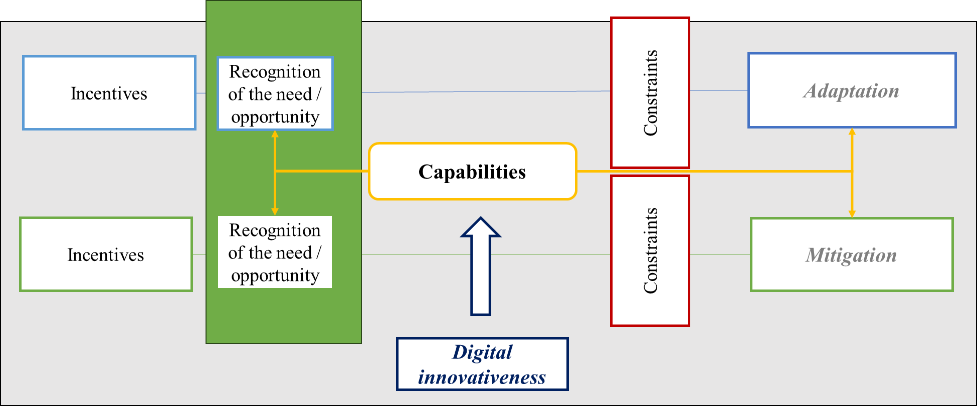
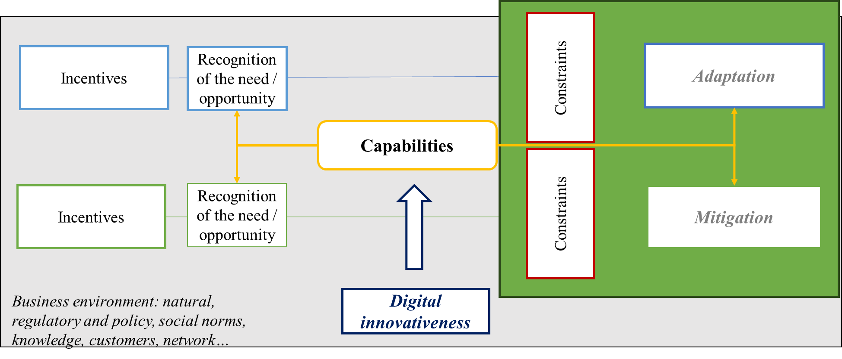
Hypothesis
Hypothesis 1. More advanced digital adopters have better ability to access and process information and hence more likely to recognise the need of climate response(s) by making strategic choice of adopting climate adaptation or climate mitigation measures, or both.
Probability of climate response(s)
Hypothesis 2.
More advanced digital adopters are more intensively engaged in climate adaptation actions
More advanced digital adopters are more intensively engaged in climate mitigation actions
Intensity of climate response(s)

Slide 26
Data overview
European Investment Bank Investment Survey, 2022-2023,
pooled cross-section ~25,000 firms across 27 EU countries and USA
Probability of climate response(s)
Intensity of climate response(s)
Type of climate response (0 to 3):
0 – No climate response;
1 – Adaptation only;
2 – Mitigation only;
3 – Both Adaptation and Mitigation
ICA - Intensity of Climate Adaptation
(0 to 3)
measured by number of CA practices adopted
ICM - Intensity of Climate Mitigation
(0 to 5)
measured by number of CM practices adopted

Slide 27
Data overview

Slide 28
Data overview
European Investment Bank Investment Survey, 2022-2023,
pooled cross-section ~25,000 firms across 27 EU countries and USA
Digital adopters’ categories (1 to 5):
1 – Digital Laggards
2 – Digital Late majority
3 – Digital Early majority
4 – Digital Early adopters
5 – Digital Innovators
Traditional
Sceptical
Deliberate
Respect
Venturesome
Laggards
16%
Late
majority
34%
Early majority
34%
Early adopters
13.5%
Innovators
2.5%
$$\overline{x}−sd$$
$$\overline{x}$$
$$\overline{x}+sd$$
$$\overline{x}+2sd$$
$$digital innovativeness$$
Digital innovativeness (0 to 8):
Constructed as a composite measure based on information for each of the 4 ‘state-of-the art for the sector’ digital technologies
0 – Firm did not adopt the technology;
1 – Adopted partially;
2 – Adopted fully

Slide 29
Data overview
Digital adopters’ categories by firm size

Slide 30
Data overview
Digital adopters’ categories by sector
In Information and Communication sector, percentage of digital innovators is over 10%

Slide 31
Data overview
Type of climate response(s) by digital adopters’ categories

Slide 32
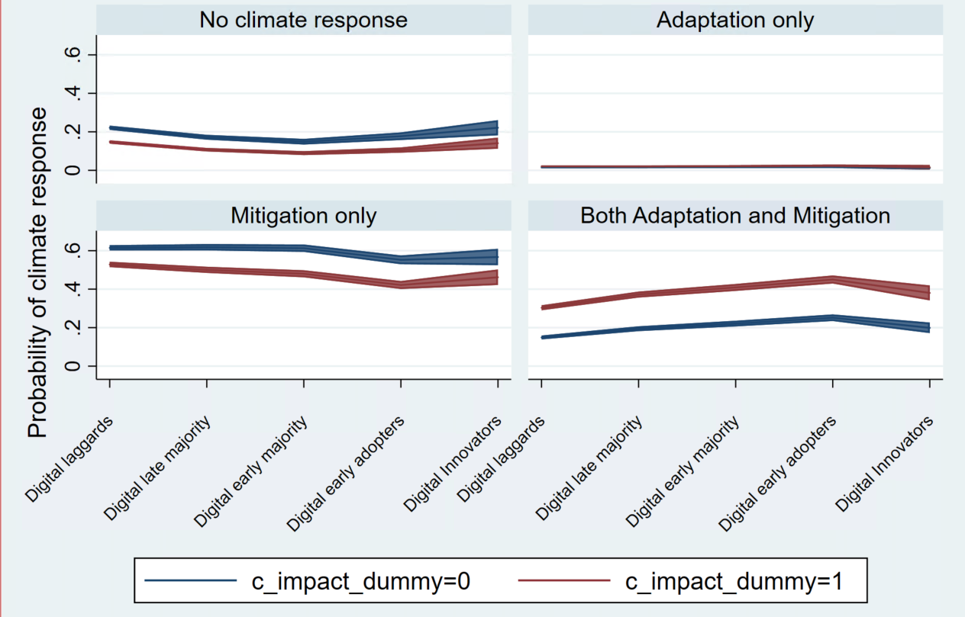
Results
Probability of climate response(s)
Probability of climate response(s) conditional on perception of climate change impact on business
Digitally more advanced firms are more likely to formulate simultaneous adaptation and mitigation response to climate change.
e.g. Digital early adopters are 12.6 percentage points more likely than digital laggards to undertake CA and CM simultaneously.
Probability of simultaneous climate response is higher for firms saying that climate changes currently have impact (minor or major) on the business.

Slide 33
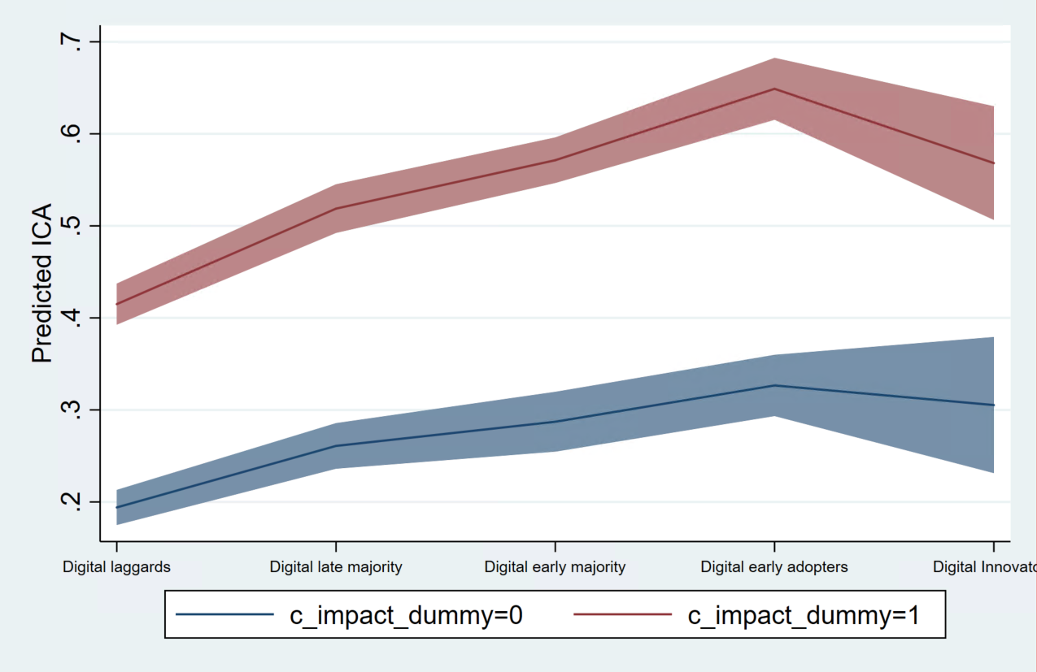
Results
Intensity of climate response(s)
Predicted intensity of climate adaptation (ICA) conditional on perception of climate change impact on business
Climate change perceptions play a moderating role: firms experiencing climate change impact on the business are more intensively engaged with CA.
Digitally more advanced firms are more intensively engaged in climate adaptation actions.
Non-linear relationship: Digital early adopters show higher ICA compared to digital innovators.

Slide 34
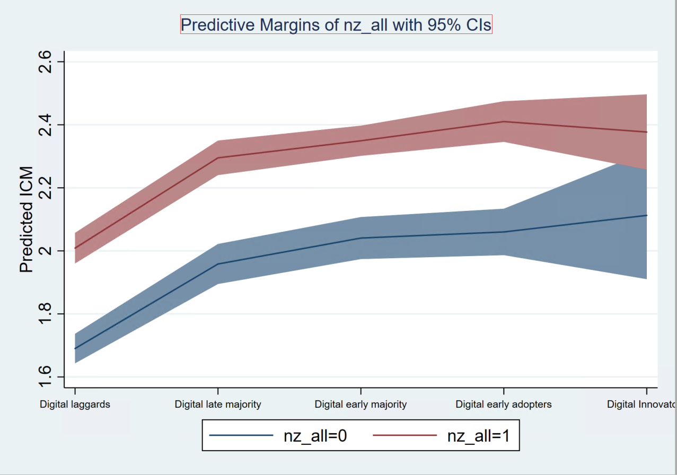
Results
Intensity of climate response(s)
Predicted intensity of climate mitigation (ICM) conditional on risk/opportunity perception of transition to stricter climate standards and regulations in the next five years
Perceptions of risk/opportunity play a moderating role: firms perceiving a risk/opportunity of green transition in the future are more intensively engaged with CM.
Digitally more advanced firms are more intensively engaged in climate mitigation actions.

Slide 35
Results
Results are robust to other specifications.
To address potential endogeneity issue, additional IV analysis was conducted. We instrument digital adopters’ categories by variables related to the performance of digital infrastructure at NUTS2 level: fixed average download and upload speed, latency, etc.
The results confirm positive relationship between the stage of digital advancement and ICA and ICM.

Slide 36
Results
Intensity of Climate Adaptation (ICA)
Intensity of climate Mitigation (ICM)
Sector
More advanced digital adopters are more intensively engaged in climate adaptation actions across all sectors, i.e. effect is rather homogeneous.
Idem.
In Manufacturing and Services, there is an increasing benefit of progressing on digital ladder on ICM, which cannot be observed in Construction and Infrastructure where first stepping from laggards to digital late majority has already substantial benefits.
Size
More advanced digital adopters are more intensively engaged in climate adaptation actions across all firm sizes with some nuances.
For micro and small businesses even a small improvement in digital passing from Digital laggards to 2nd and 3rd groups have much higher impact on ICA compared to medium and large businesses.
Idem

Slide 37
Concluding remarks
Robust evidence of Twin digital and green transition at firm level
Low uptake of adaptation measures – low resilience?: despite private benefits of climate adaptation (business continuity and resilience), the rate of uptake of CA measures is very small.
Double importance - role of digital in:
Ability to recognise the need/opportunity to develop climate response(s) leading to a climate response strategy
Ability to act on this choice by intensifying engagement
Not a substitution: digitally enabled businesses choose to do both Adaptation and Mitigation in response to climate change
Shaped by perceptions: the relationship between digital and CA and CM is also shaped by perceived business exposure and vulnerability to climate change and perception of risk/opportunity associated with transition to stricter climate standards and regulations.

Slide 38
Link to the manifesto for small business growth and productivity
Increase the adoption of digital technologies
…by increasing digital literacy and awareness
“We need more UK businesses to adopt digital technologies that can in turn improve their productivity. ERC research has shown that digital adoption is important for improving productivity in small firms. Targeted support programmes and peer networking have been shown to be helpful in raising the confidence of business leaders in terms of technology adoption. However, digital readiness is key to adoption, and creating more ‘digitally ready’ firms should be a policy focus. There are potential productivity benefits in targeting those firms that do not currently recognise the benefits of digital transformation for their businesses.”

Slide 39
Link to the manifesto for small business growth and productivity
Improve the provision of quality, actionable information on net zero
…and develop agreed standards for measuring environmental impact
“The UK’s small businesses urgently need access to information and advice to help them adopt net zero practices and measure their effectiveness. Small and medium sized businesses are estimated to account for around half of all UK business emissions, and as such they will play a crucial part in the net zero transition. ERC research has shown, however, that there is much room for improvement when it comes to the adoption of net zero practices in small firms in the UK, especially amongst the smallest firms. The evidence shows that the problem with adoption is not around intentions when it comes to sustainability – but more around bandwidth, prioritisation and capability. At present the net zero support landscape is fragmented, with only a small minority of firms receiving support. Access to trusted and actionable information is vital in supporting firms to implement sustainability practices, with government, professional and industry associations all playing potentially important roles. There are also potential advantages in designing future policy support that grasps the complementary benefits of net zero and digital adoption.”

Slide 40
Rural SMEs, environmental action, and perceived opportunities
Kevin Mole

Slide 41
Rural SMEs, Environmental Action, and Perceived Opportunities
State of Rural Enterprise Report nos. 2 & 3
Dr Kevin Mole with Serdal Ozusaglam, Stephen Roper and Panagiotis Kyriakopoulos

Slide 42
Environment

Slide 43
Introduction
Previous NICRE research highlights rural firms more likely (45%) than urban firms (37%) to take the environment into account when making decisions (Wishart et al. 2021)
Businesses are on a journey in terms of their environmental practices
Much of the support for Net Zero does not consider rural aspects
Drivers of environmental action include consumer pressure, competition, stakeholder perspectives (e.g attitude of senior managers), external pressures and legislation
Barriers include cost pressures, lack of knowledge and, in rural areas, transport costs

Slide 44
Including the environment in decision-making
41% of rural businesses always consider the environmental impact, compared to 37% of urban businesses.
45% of rural businesses sometimes consider it (42% urban).
14% of rural businesses never consider the environmental impact (21% urban).
Notes:
Perhaps just mention larger firms appear more environmentally conscious.

Slide 45
Knowing where to find reliable information to help
Rural firms (69%) more likely to know where to find help than urban firms (66%), but uneven:
South West rural firms more likely to know where to find reliable information than in North East and West Midlands.
North East rural firms less likely than urban firms to know where to find information, with reverse situation in South West and West Midlands.

Slide 46
Taking steps to reduce environmental impact
54% of businesses ‘take environmental action’.
More rural firms (57%) take action (53% in urban areas).
Driven by contrast between rural and urban enterprises in the West Midlands, where 55% of rural and 47% of urban businesses have taken action.
Notes:
Perhaps mention firms with more employees more likely to take action

Slide 47
The ladder of environmental action

Slide 48
Very few businesses measure their emissions
Just 3% rural and 5% urban businesses measured their GHG emissions “using an online calculator”.
4% of rural and urban businesses measured GHG emissions through “working with a consultant or external company”.

Slide 49
Rural businesses more likely to face barriers in their efforts to reduce carbon emissions
Notes:
Perhaps just mention that Smallest microbusinesses report fewer restrictions in their efforts to reduce carbon emissions

Slide 50
What are the barriers?
Cost of adopting greener technology
Access to info, people and skills development, especially in urban areas.
Regulatory complexity less a concern.
Lack of people locally to advise on Net Zero indicates a perceived lack of support.
Rural firms more likely to report being constrained; urban firms report a wider variety of obstacles.

Slide 51
What benefits does environmental action bring?
Notes:
Perhaps just mention more South-West firms report reputation gains from Net Zero?

Slide 52
Conclusion – encouraging steps but we need to climb the ladder
Most businesses in rural and urban areas take the environment into account when making decisions.
Most have acted to reduce environmental footprint.
There is a ‘ladder’ of environmental action with recycling and waste reduction on the lower rungs.
The middle rungs show 26% implementing process changes to reduce carbon emissions.
21% have introduced new products and services, indicating a growing trend towards environmentally responsible innovation.
Environmental audits, certification, and greenhouse gas emissions measurement prove more complex, particularly in rural areas.

Slide 53
Rural opportunities

Slide 54
An opportunity-driven mindset
Businesses have faced perfect storm – disruption due to pandemic followed by ‘cost of doing business crisis’. All in context of wider climate crisis
Are changing conditions simply deepening deficits often discussed in terms of rural firms or are they creating new opportunities?
Is there an ability and willingness to invest to realise post-pandemic opportunities?
We ask:
What opportunities are in your area?
How well placed are you to take advantage of these?

Slide 55
Health and wellbeing and the environment provide opportunities for local business growth
Urban firms more likely to see opportunities related to health and well-being (rural 47%, urban 52%).
Rural firms more focused on environmental/ green products and services (rural 44%, urban 40%).
Fewer identify opportunities linked to data skills and use of data, tourism, and exporting.
Notes:
Could mention in speaking notes that some regional differences e.g. North-East firms eye tourism opportunities
Or just allude to some size businesses. E.g. Medium sized firms more likely to identify health and tourism. Larger firms more likely to perceive opportunities to provide health and well-being services and products. Smaller companies perceive stronger opportunities in environmental / green services and products. Micro firms less likely to identify tourist opportunities but more likely to highlight improvements in data skills and use of data.
Could replacing title with survey question

Slide 56
39% see themselves as well placed to take advantage of opportunities
An equal proportion (39%) of rural and urban firms reported that their businesses are either ‘very well’ or ‘well’ placed for potential opportunities.
But more North East firms see themselves as well-placed.

Slide 57
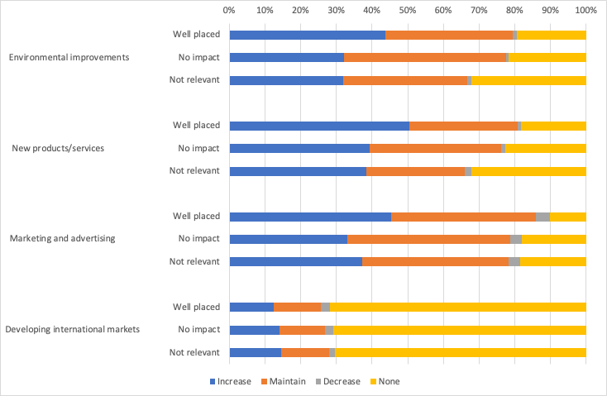
Well placed firms more likely to invest
Well placed firms more likely to invest in environmental improvements, new products, marketing.
But developing international markets is different.
Notes:
Figure particularly difficult to read

Slide 58
Perceived constraints by firm size: micro lack money; medium sized lack people
More medium sized firms report staff recruitment and retention, lack of transport, but more microbusinesses report a lack of financial resources
Notes:
Full text in graph cannot be read / perhaps no need for bullet text – just mention from speaking notes about some size effects?

Slide 59
From opportunities to investment
Opportunities
Widespread perception among rural firms of opportunities for developing products or services related to health and well-being, as well as developing environmental or green products or services.
Firms which see themselves well placed to take advantage of local growth opportunities more likely planning to increase or maintain levels of investment in environmental improvements, new products, marketing, well-being and training.
Familiar challenges threaten rural firms’ ability to grasp the opportunities available, however, suggesting continued importance of initiatives focused on improving rural transport, housing and broadband.
Well-placed
Investment
Constraints

Slide 60
Link to the manifesto for small business growth and productivity
Improve the provision of quality, actionable information on net zero
…and develop agreed standards for measuring environmental impact
“The UK’s small businesses urgently need access to information and advice to help them adopt net zero practices and measure their effectiveness. Small and medium sized businesses are estimated to account for around half of all UK business emissions, and as such they will play a crucial part in the net zero transition. ERC research has shown, however, that there is much room for improvement when it comes to the adoption of net zero practices in small firms in the UK, especially amongst the smallest firms. The evidence shows that the problem with adoption is not around intentions when it comes to sustainability – but more around bandwidth, prioritisation and capability. At present the net zero support landscape is fragmented, with only a small minority of firms receiving support. Access to trusted and actionable information is vital in supporting firms to implement sustainability practices, with government, professional and industry associations all playing potentially important roles. There are also potential advantages in designing future policy support that grasps the complementary benefits of net zero and digital adoption.”

Slide 61
Workplace mental health in England, Ireland and Sweden – a comparative study
Maria Wishart

Slide 62
Workplace mental health in England, Ireland and Sweden: a comparative study
Why England, Ireland and Sweden?
The dataset
Findings:
Mental health absence and its impact
Presenteeism
Uptake of initiatives
Hybrid working
Conclusions and implications

Slide 63
Healthcare overview
 | Ireland | England | Sweden
Population | 5,194,336 | 67,736,802 | 10,521,556
Healthcare funding model | Two tier public/private healthcare system, private healthcare insurance common | Publicly funded, private care available for those choosing it | Publicly funded, private care has less of a role than in UK and Ireland
Primary care access | Free primary care for around 30% of population | Universal free access to primary care | Universal free access to primary care
Sick pay | Statutory sick pay for 5 days per year | Statutory sick pay for up to 28 weeks | 80% of salary for 364 days, extendable

Slide 64
Proportion of adults with mental disorders
OECD/European Union (2018)

Slide 65
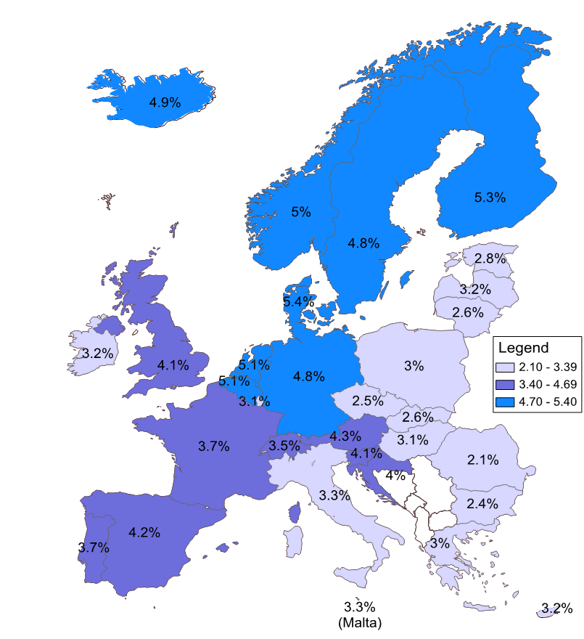
Estimated direct and indirect costs related to mental health problems across EU countries, % of GDP
OECD/European Union (2018)

Slide 66
Estimated direct and indirect costs related to mental health problems % of GDP
 | Total costs |  | Direct costs |  |  |  | Indirect costs
 |  |  | On health systems |  | On social benefits |  | On the labour market
 | in million EUR | % of GDP | in million EUR | % of GDP | in million EUR | % of GDP | in million EUR | % of GDP
EU28 | 607 074 | 4.10% | 194 139 | 1.31% | 169 939 | 1.15% | 242 995 | 1.64%
Ireland | 8 299 | 3.17% | 2 232 | 0.85% | 1 891 | 0.72% | 4 176 | 1.59%
Sweden | 21 677 | 4.83% | 5 696 | 1.27% | 7 558 | 1.68% | 8 423 | 1.88%
UK | 106 024 | 4.07% | 36 353 | 1.40% | 22 704 | 0.87% | 46 967 | 1.80%

Slide 67
Data set
Computer Assisted Telephone Interview (CATI) survey, for-profit and voluntary sector firms operating for at least 3 years, with minimum 10 employees
Ireland: Sep-Dec 2022: 1,501 firms
England: Jan-May 2023: 1,902 firms
Sweden: Sep-Dec 2023: 1,000 firms
Business and employee characteristics
General sickness and Mental health sickness absence measurement & practices
Mental health initiatives and outcomes
Presenteeism
Technology and high-tech working practices

Slide 68
Headlines
Significant country-level differences in:
Patterns of mental health related sickness absence
Patterns and types of presenteeism
Engagement in mental health & wellbeing initiatives
Adoption of hybrid working
Reported impact of mental health on business operations

Slide 69
Mental health related sickness absence
Proportion of firms reporting MH sickness absence in the preceding 12 months
Sweden 1,000 firms, England 1,878 firms, Ireland 1,484 firms

Slide 70
Mental health related sickness absence
Proportion of firms with long-term MH absence
Proportion of firms with repeated MH absence
Sweden 400 firms, England 471 firms, Ireland 291 firms

Slide 71
Mental health related sickness absence
Proportion of firms reporting that MH sickness absence impacted operations
Sweden 400 firms, England 471 firms, Ireland 291 firms

Slide 72
Presenteeism
Proportion of firms reporting presenteeism in the preceding 12 months
Sweden 1,000 firms, England 1,902 firms, Ireland 1,501 firms

Slide 73
Presenteeism
Type of presenteeism reported, by country
Addressing presenteeism, by country
Sweden 543 firms, England 692 firms, Ireland 417 firms

Slide 74
Engagement in Mental Health & Wellbeing initiatives
Proportion of firms disagreeing that MH is a personal issue that should not be addressed at work, by country
Proportion of firms offering MH initiatives, by country & size
Sweden 1,000 firms, England 1,902 firms, Ireland 1,501 firms

Slide 75
Engagement in Mental Health & Wellbeing initiatives
Adoption of strategic/policy initiatives, by country
Adoption of skills training & monitoring initiatives, by country
Sweden 784 firms, England 970 firms, Ireland 722 firms

Slide 76
Engagement in Mental Health & Wellbeing initiatives
Adoption of workplace practices to reduce risk factors, by country
Investments in employee wellbeing, by country
Sweden 784 firms, England 970 firms, Ireland 722 firms

Slide 77
Hybrid working
Hybrid working, by country
Sweden 1,000 firms, England 1,894 firms, Ireland 1,499 firms

Slide 78
Hybrid working
Encouraging a good work life balance for remote workers, by country
Sweden 295 firms, England 438 firms, Ireland 404 firms

Slide 79
Conclusions
Significant differences in MH absence, presenteeism and hybrid working - role of culture and socio-political context
Despite reporting higher levels of MH absence, Swedish firms significantly less likely to report impacts of MH in the workplace
Swedish firm interventions more likely to be focused on strategic initiatives and investment in employees than on training and reducing risk factors

Slide 80
Implications?
Mental health-related absence: should we be minimising or managing it?
Encouraging work life balance with more embedded remote working: how should employers manage psychological detachment issues?
Presenteeism: is more presenteeism an inevitable consequence of remote working, and if so, what should we do to address it?
Mental health initiatives in the workplace: what should policymakers do to encourage the adoption of mental health initiatives in the workplace? Which kinds of initiatives should they encourage?

Slide 81
Link to the manifesto for small business growth and productivity
Transform understanding about the connection between mental health and productivity
…through improving access to information, training and support
“We need to transform understanding amongst small business leaders of the importance of good mental health and wellbeing for productivity and improve management behaviour in this area. The pandemic and subsequent cost of living crisis has had major implications for the mental health and wellbeing of the workforce and for business leaders, with serious implications for business performance. ERC research has shown that presenteeism has increased and has now surpassed pre-pandemic levels, and that new working practices have brought new challenges. Although awareness of mental health issues amongst employers has increased and more initiatives to improve support for employees have been introduced, there is still considerable room for improvement, particularly amongst the smallest firms. Looking ahead, firms will need to be more engaged with the range of initiatives, advice and support available and more carefully consider the wellbeing impacts of their management practices. More attention needs to be paid specifically to the training and support of line managers, who are often in the front-line in dealing with the mental health issues experienced by employees. Small business leaders and entrepreneurs themselves also need access to support in dealing with the mental health challenges associated with running a business in times of financial uncertainty and insecurity.”

Slide 82
ERC manifesto for small business growth and productivity
Vicki Belt

Slide 83
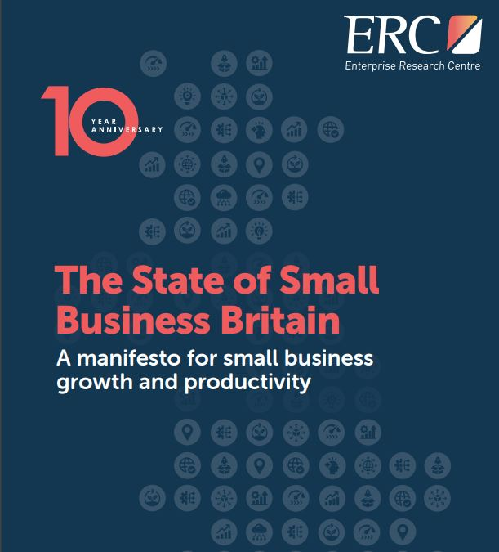

Slide 84
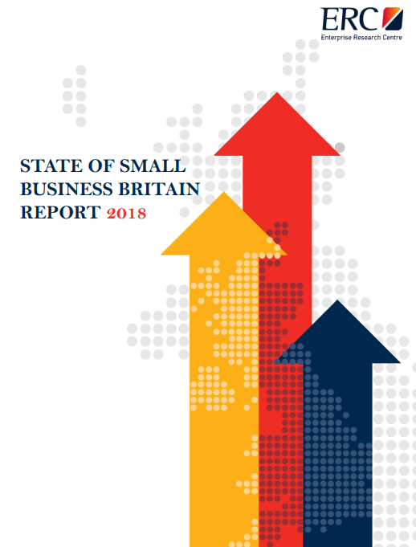
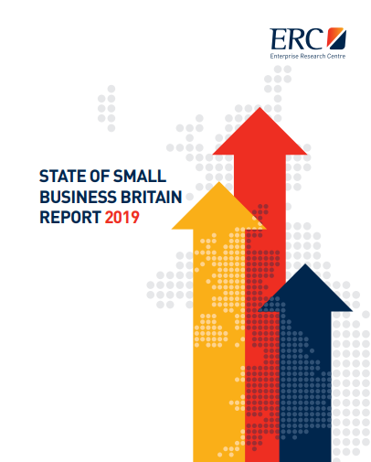
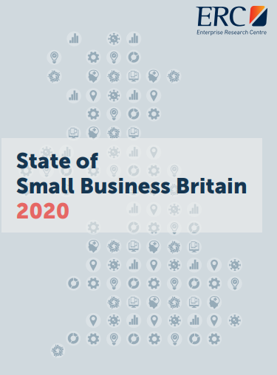
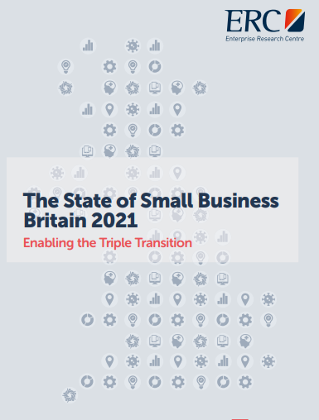
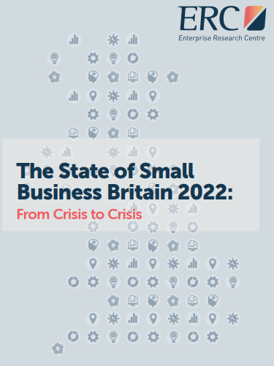
The State of Small Business Britain: A manifesto for small business growth and productivity
The ERC’s annual review of trends and issues affecting small businesses
This time bringing together an entire decade of research insights!
110 research papers
61 research reports
60 SOTA Reviews
49 Insight papers
Plus, numerous academic papers
…and thousands of conversations with stakeholders and businesses
A range of themes… from a focus on what prompts business growth to broader concerns with productivity and sustainability

Slide 85
A decade of change
A growing small business population in the UK
5.5 million small businesses in 2023 – growth driven disproportionately by the smallest, non-employing businesses
A nation of entrepreneurs - around one in three adults in the UK now either running a business or looking at starting one
But small businesses have faced some extreme pressures…
Resilience has become a crucial trait

Slide 86
What promotes growth and productivity in small businesses?
ERC research has shown that small business growth is multi-faceted and complex
The volume of start-ups is not the problem - survival, scaling up and productivity is
ERC research has provided evidence that a range of factors are important:
But… the proportion of businesses undertaking some of these key growth-related behaviours (e.g. innovation, accessing finance, exporting) has lowered in the past few years

Slide 87
Access to finance
Seeking external finance is positively associated with faster growth and productivity
But most UK small firms are permanent ‘non-borrowers’
Shift in the willingness of small firms to seek finance since the GFC
Reasons include inadequate information, fear of rejection, lack of focus on growth
Evidence of the positive impact of Covid-19 financial support initiatives
Inequalities exist by gender and ethnicity, also spatially
As well as access to finance, late payment is also a major (under-appreciated?) issue

Slide 88
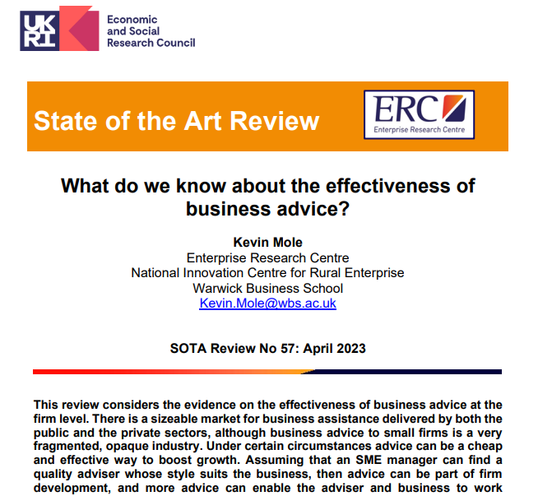
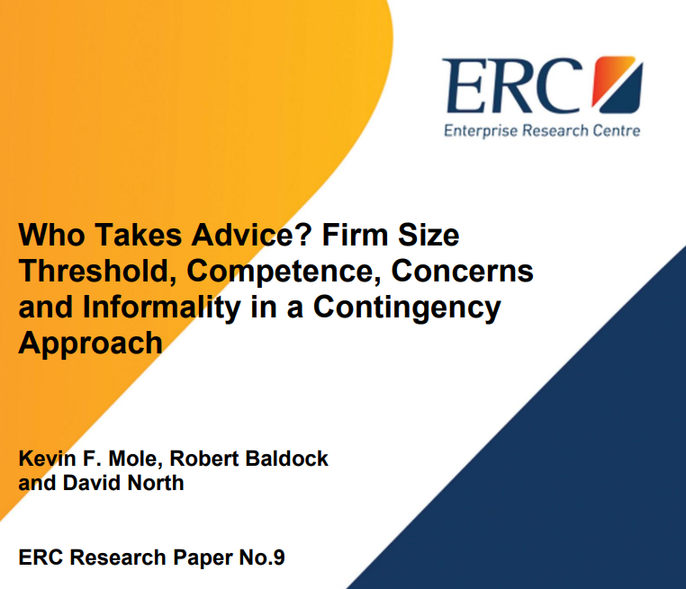
Business support
Plays a role in business survival and growth, way of diffusing best practice to small businesses
But the UK business support system is fragmented and unstable
Uptake varies by range of factors, e.g. firm size and educational level of leaders
Lack of tailored support for disadvantaged groups
Quality of advice and personal relationships and expertise are important
Firms also need to be ‘ready, willing and able’ to take on board advice
Many firms first seek advice when they are already at the point of crisis - too late?

Slide 89
Innovation
Strong link to survival, growth and productivity - new market opportunities, new ways of working
Proportion of innovation-active firms in the UK has fallen sharply in recent years
Impacts of economic shocks on innovation behaviour
Spatial patterns of innovation - the ‘arc of innovation’, local strengths and weaknesses
Range of factors influence innovation - openness and collaboration, absorptive capacity, diversity, exporting
Benefits of publicly-funded support for innovation - R&D grants, R&D tax credits, and academic-industry collaborations, importance of ‘policy mix’

Slide 90
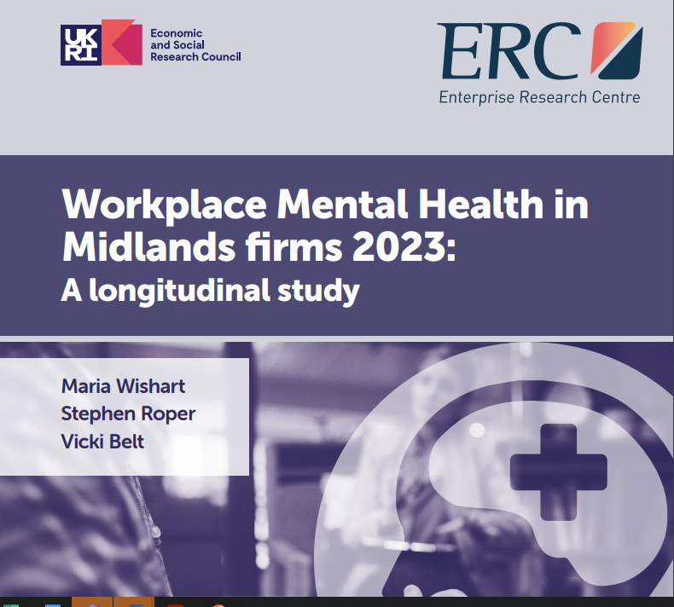
Management and leadership
Positive associations between M&L and growth and productivity
Importance of ‘growth-oriented’ actions - knowledge flows, risk-taking and innovation
Link between use of key HRM practices and innovation
HPW practices important in high growth firms, bundles of practices effective
Positive work cultures and informal HR practices are associated with sustained growth
Links between workplace mental health and wellbeing and productivity
Pandemic challenges - new ways of working and rise in mental health issues
Room for improvement in adoption of HPW and strategic approaches to mental health

Slide 92
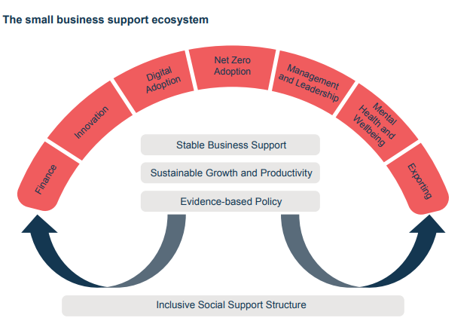

Slide 94
Looking ahead –
ERC plans for 2024
Stephen Roper

Slide 95
What’s coming up? ERC through 2024

Slide 97
Projects and partnerships
Export decisions and mindsets – reporting due February 2024 (DBT and ESRC)
Investment mindsets – what shapes investment decisions in the UK? (Productivity Institute)
Mental health, wellbeing and productivity in the workplace – new survey data for 2024q1 and more on the benchmark comparisons (ESRC, Nottingham, Lancaster, Queens)
Panel study of entrepreneurship – with a focus on ethnic minority entrepreneurs (Mastercard, Be-the-Business)

Slide 98
Projects and partnerships
Twin transitions study continues (Productivity Institute, EIB)
Innovation with new survey data for 2024Q2 and related work on inclusive innovation) (IUK, UCC)
Infrastructure for commercialization in agri-tech (and other aspects of the effectiveness of the R&I system) (IRC, Oxford Brookes, Manchester, Birkbeck)
Supporting rural enterprise (NICRE, Newcastle, Gloucester and RAU, Stratford Council)

Slide 99
How can ERC help you?
Rapid or systematic literature reviews
Collaborative primary research
Survey conduct and/or data matching
Supporting policy development and design
Building internal capacity (teach-ins)
Convene round-tables or expert groups

Slide 100
Thank you
For further details please visit :
www.enterpriseresearch.ac.uk
@ERC_UK

