Slide 1
Rural SMEs, Environmental Action, and Perceived Opportunities
State of Rural Enterprise Report nos. 2 & 3
Dr Kevin Mole with Serdal Ozusaglam, Stephen Roper and Panagiotis Kyriakopoulos

Slide 2
Environment

Slide 3
Introduction
Previous NICRE research highlights rural firms more likely (45%) than urban firms (37%) to take the environment into account when making decisions (Wishart et al. 2021)
Businesses are on a journey in terms of their environmental practices
Much of the support for Net Zero does not consider rural aspects
Drivers of environmental action include consumer pressure, competition, stakeholder perspectives (e.g attitude of senior managers), external pressures and legislation
Barriers include cost pressures, lack of knowledge and, in rural areas, transport costs

Slide 4
Including the environment in decision-making
41% of rural businesses always consider the environmental impact, compared to 37% of urban businesses.
45% of rural businesses sometimes consider it (42% urban).
14% of rural businesses never consider the environmental impact (21% urban).
Notes:
Perhaps just mention larger firms appear more environmentally conscious.

Slide 5
Knowing where to find reliable information to help
Rural firms (69%) more likely to know where to find help than urban firms (66%), but uneven:
South West rural firms more likely to know where to find reliable information than in North East and West Midlands.
North East rural firms less likely than urban firms to know where to find information, with reverse situation in South West and West Midlands.

Slide 6
Taking steps to reduce environmental impact
54% of businesses ‘take environmental action’.
More rural firms (57%) take action (53% in urban areas).
Driven by contrast between rural and urban enterprises in the West Midlands, where 55% of rural and 47% of urban businesses have taken action.
Notes:
Perhaps mention firms with more employees more likely to take action

Slide 7
The ladder of environmental action

Slide 8
Very few businesses measure their emissions
Just 3% rural and 5% urban businesses measured their GHG emissions “using an online calculator”.
4% of rural and urban businesses measured GHG emissions through “working with a consultant or external company”.

Slide 9
Rural businesses more likely to face barriers in their efforts to reduce carbon emissions
Notes:
Perhaps just mention that Smallest microbusinesses report fewer restrictions in their efforts to reduce carbon emissions

Slide 10
What are the barriers?
Cost of adopting greener technology
Access to info, people and skills development, especially in urban areas.
Regulatory complexity less a concern.
Lack of people locally to advise on Net Zero indicates a perceived lack of support.
Rural firms more likely to report being constrained; urban firms report a wider variety of obstacles.

Slide 11
What benefits does environmental action bring?
Notes:
Perhaps just mention more South-West firms report reputation gains from Net Zero?

Slide 12
Conclusion – encouraging steps but we need to climb the ladder
Most businesses in rural and urban areas take the environment into account when making decisions.
Most have acted to reduce environmental footprint.
There is a ‘ladder’ of environmental action with recycling and waste reduction on the lower rungs.
The middle rungs show 26% implementing process changes to reduce carbon emissions.
21% have introduced new products and services, indicating a growing trend towards environmentally responsible innovation.
Environmental audits, certification, and greenhouse gas emissions measurement prove more complex, particularly in rural areas.

Slide 13
Rural opportunities

Slide 14
An opportunity-driven mindset
Businesses have faced perfect storm – disruption due to pandemic followed by ‘cost of doing business crisis’. All in context of wider climate crisis
Are changing conditions simply deepening deficits often discussed in terms of rural firms or are they creating new opportunities?
Is there an ability and willingness to invest to realise post-pandemic opportunities?
We ask:
What opportunities are in your area?
How well placed are you to take advantage of these?

Slide 15
Health and wellbeing and the environment provide opportunities for local business growth
Urban firms more likely to see opportunities related to health and well-being (rural 47%, urban 52%).
Rural firms more focused on environmental/ green products and services (rural 44%, urban 40%).
Fewer identify opportunities linked to data skills and use of data, tourism, and exporting.
Notes:
Could mention in speaking notes that some regional differences e.g. North-East firms eye tourism opportunities
Or just allude to some size businesses. E.g. Medium sized firms more likely to identify health and tourism. Larger firms more likely to perceive opportunities to provide health and well-being services and products. Smaller companies perceive stronger opportunities in environmental / green services and products. Micro firms less likely to identify tourist opportunities but more likely to highlight improvements in data skills and use of data.
Could replacing title with survey question

Slide 16
39% see themselves as well placed to take advantage of opportunities
An equal proportion (39%) of rural and urban firms reported that their businesses are either ‘very well’ or ‘well’ placed for potential opportunities.
But more North East firms see themselves as well-placed.

Slide 17
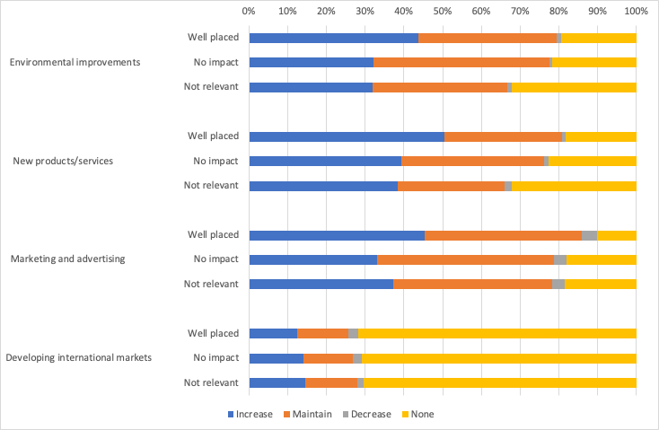
Well placed firms more likely to invest
Well placed firms more likely to invest in environmental improvements, new products, marketing.
But developing international markets is different.
Notes:
Figure particularly difficult to read

Slide 18
Perceived constraints by firm size: micro lack money; medium sized lack people
More medium sized firms report staff recruitment and retention, lack of transport, but more microbusinesses report a lack of financial resources
Notes:
Full text in graph cannot be read / perhaps no need for bullet text – just mention from speaking notes about some size effects?

Slide 19
From opportunities to investment
Opportunities
Widespread perception among rural firms of opportunities for developing products or services related to health and well-being, as well as developing environmental or green products or services.
Firms which see themselves well placed to take advantage of local growth opportunities more likely planning to increase or maintain levels of investment in environmental improvements, new products, marketing, well-being and training.
Familiar challenges threaten rural firms’ ability to grasp the opportunities available, however, suggesting continued importance of initiatives focused on improving rural transport, housing and broadband.
Well-placed
Investment
Constraints

