Slide 1
Workplace mental health in England, Ireland and Sweden: a comparative study
Maria Wishart
Maria.Wishart@wbs.ac.uk

Slide 2
Workplace mental health in England, Ireland and Sweden: a comparative study
Why England, Ireland and Sweden?
The dataset
Findings:
Mental health absence and its impact
Presenteeism
Uptake of initiatives
Hybrid working
Conclusions and implications

Slide 3
Healthcare overview
 | Ireland | England | Sweden
Population | 5,194,336 | 67,736,802 | 10,521,556
Healthcare funding model | Two tier public/private healthcare system, private healthcare insurance common | Publicly funded, private care available for those choosing it | Publicly funded, private care has less of a role than in UK and Ireland
Primary care access | Free primary care for around 30% of population | Universal free access to primary care | Universal free access to primary care
Sick pay | Statutory sick pay for 5 days per year | Statutory sick pay for up to 28 weeks | 80% of salary for 364 days, extendable

Slide 4
Proportion of adults with mental disorders
OECD/European Union (2018)

Slide 5
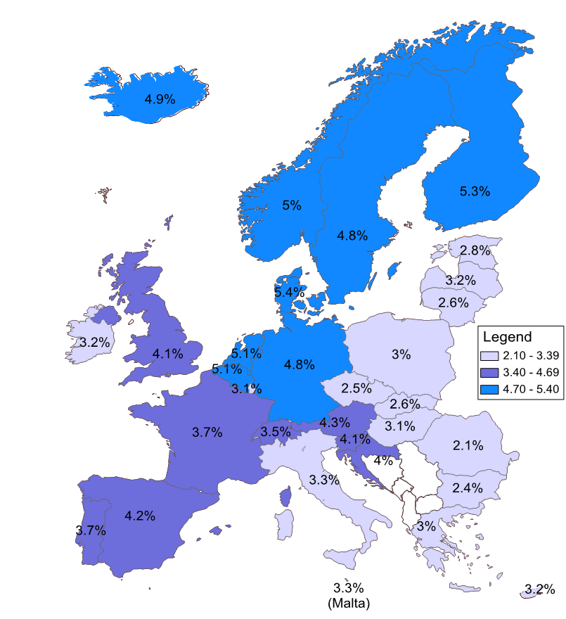
Estimated direct and indirect costs related to mental health problems across EU countries, % of GDP
OECD/European Union (2018)

Slide 6
Estimated direct and indirect costs related to mental health problems % of GDP
 | Total costs |  | Direct costs |  |  |  | Indirect costs
 |  |  | On health systems |  | On social benefits |  | On the labour market
 | in million EUR | % of GDP | in million EUR | % of GDP | in million EUR | % of GDP | in million EUR | % of GDP
EU28 | 607 074 | 4.10% | 194 139 | 1.31% | 169 939 | 1.15% | 242 995 | 1.64%
Ireland | 8 299 | 3.17% | 2 232 | 0.85% | 1 891 | 0.72% | 4 176 | 1.59%
Sweden | 21 677 | 4.83% | 5 696 | 1.27% | 7 558 | 1.68% | 8 423 | 1.88%
UK | 106 024 | 4.07% | 36 353 | 1.40% | 22 704 | 0.87% | 46 967 | 1.80%

Slide 7
Data set
Computer Assisted Telephone Interview (CATI) survey, for-profit and voluntary sector firms operating for at least 3 years, with minimum 10 employees
Ireland: Sep-Dec 2022: 1,501 firms
England: Jan-May 2023: 1,902 firms
Sweden: Sep-Dec 2023: 1,000 firms
Business and employee characteristics
General sickness and Mental health sickness absence measurement & practices
Mental health initiatives and outcomes
Presenteeism
Technology and high-tech working practices

Slide 8
Headlines
Significant country-level differences in:
Patterns of mental health related sickness absence
Patterns and types of presenteeism
Engagement in mental health & wellbeing initiatives
Adoption of hybrid working
Reported impact of mental health on business operations

Slide 9
Mental health related sickness absence
Proportion of firms reporting MH sickness absence in the preceding 12 months
Sweden 1,000 firms, England 1,878 firms, Ireland 1,484 firms

Slide 10
Mental health related sickness absence
Proportion of firms with long-term MH absence
Proportion of firms with repeated MH absence
Sweden 400 firms, England 471 firms, Ireland 291 firms

Slide 11
Mental health related sickness absence
Proportion of firms reporting that MH sickness absence impacted operations
Sweden 400 firms, England 471 firms, Ireland 291 firms

Slide 12
Presenteeism
Proportion of firms reporting presenteeism in the preceding 12 months
Sweden 1,000 firms, England 1,902 firms, Ireland 1,501 firms

Slide 13
Presenteeism
Type of presenteeism reported, by country
Addressing presenteeism, by country
Sweden 543 firms, England 692 firms, Ireland 417 firms

Slide 14
Engagement in Mental Health & Wellbeing initiatives
Proportion of firms disagreeing that MH is a personal issue that should not be addressed at work, by country
Proportion of firms offering MH initiatives, by country & size
Sweden 1,000 firms, England 1,902 firms, Ireland 1,501 firms

Slide 15
Engagement in Mental Health & Wellbeing initiatives
Adoption of strategic/policy initiatives, by country
Adoption of skills training & monitoring initiatives, by country
Sweden 784 firms, England 970 firms, Ireland 722 firms

Slide 16
Engagement in Mental Health & Wellbeing initiatives
Adoption of workplace practices to reduce risk factors, by country
Investments in employee wellbeing, by country
Sweden 784 firms, England 970 firms, Ireland 722 firms

Slide 17
Hybrid working
Hybrid working, by country
Sweden 1,000 firms, England 1,894 firms, Ireland 1,499 firms

Slide 18
Hybrid working
Encouraging a good work life balance for remote workers, by country
Sweden 295 firms, England 438 firms, Ireland 404 firms

Slide 19
Conclusions
Significant differences in MH absence, presenteeism and hybrid working - role of culture and socio-political context
Despite reporting higher levels of MH absence, Swedish firms significantly less likely to report impacts of MH in the workplace
Swedish firm interventions more likely to be focused on strategic initiatives and investment in employees than on training and reducing risk factors

Slide 20
Implications?
Mental health-related absence: should we be minimising or managing it?
Encouraging work life balance with more embedded remote working: how should employers manage psychological detachment issues?
Presenteeism: is more presenteeism an inevitable consequence of remote working, and if so, what should we do to address it?
Mental health initiatives in the workplace: what should policymakers do to encourage the adoption of mental health initiatives in the workplace? Which kinds of initiatives should they encourage?

Slide 21
To find out more, please visit:
https://www.enterpriseresearch.ac.uk/esrc-mental-health-well-being-practices-outcomes-productivity-project/

