Slide 1
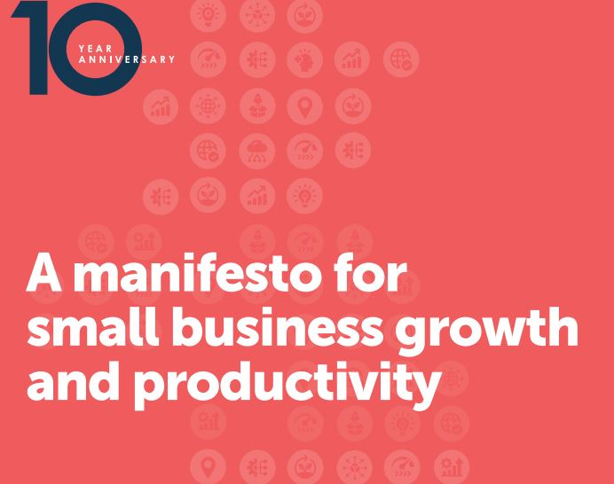
Link to the manifesto for small business growth and productivity
Improve the provision of quality, actionable information on net zero
…and develop agreed standards for measuring environmental impact
“The UK’s small businesses urgently need access to information and advice to help them adopt net zero practices and measure their effectiveness. Small and medium sized businesses are estimated to account for around half of all UK business emissions, and as such they will play a crucial part in the net zero transition. ERC research has shown, however, that there is much room for improvement when it comes to the adoption of net zero practices in small firms in the UK, especially amongst the smallest firms. The evidence shows that the problem with adoption is not around intentions when it comes to sustainability – but more around bandwidth, prioritisation and capability. At present the net zero support landscape is fragmented, with only a small minority of firms receiving support. Access to trusted and actionable information is vital in supporting firms to implement sustainability practices, with government, professional and industry associations all playing potentially important roles. There are also potential advantages in designing future policy support that grasps the complementary benefits of net zero and digital adoption.”

