Slide 1








The ERC State of Small Business Britain Report, 2024
An overview
Other Funders

Slide 2

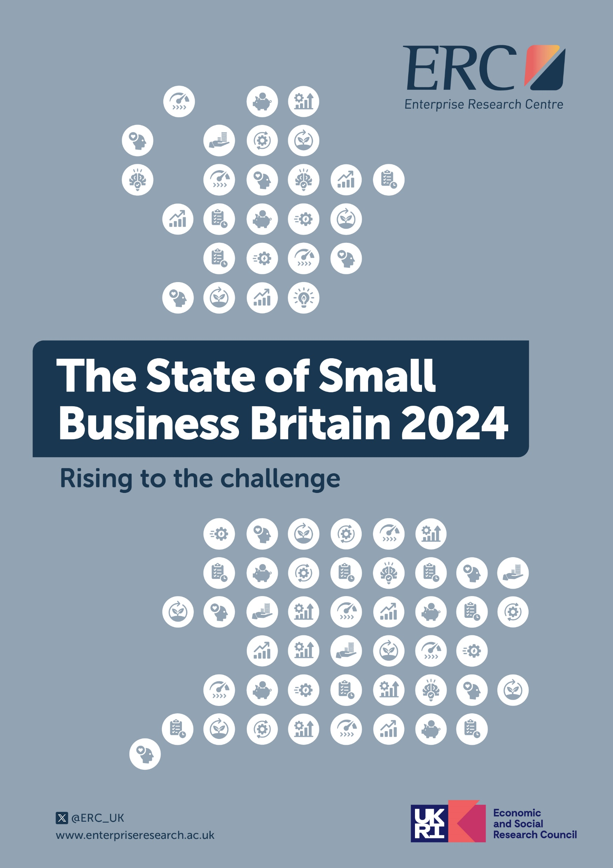
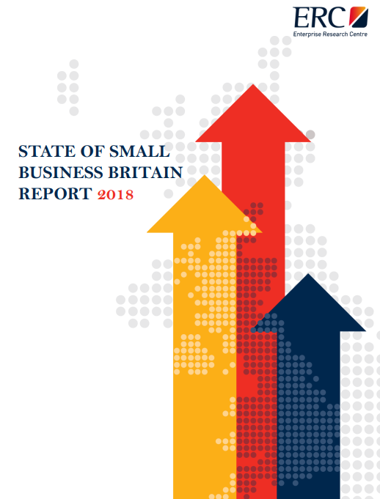
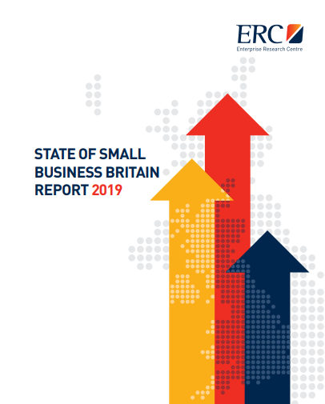
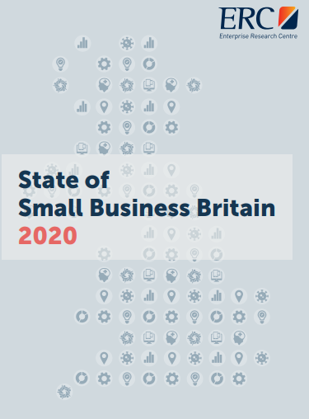
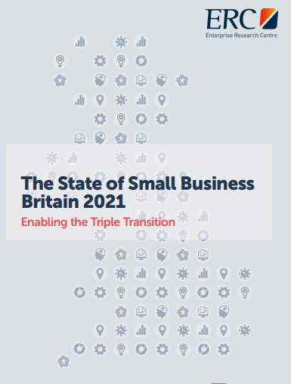
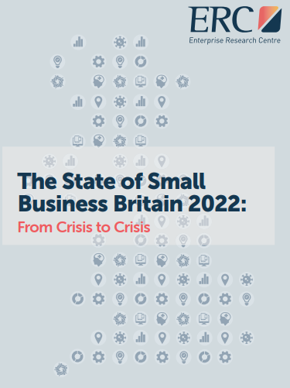
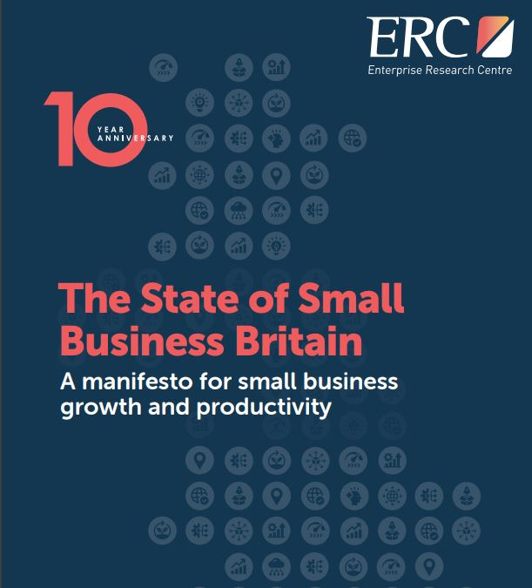
The State of Small Business Britain Report Series
The SSBB is the ERC’s annual review of trends and issues affecting small businesses
The previous version of the report brought together an entire decade of research insights
The latest report brings the story up to date, with research published during 2024
The report covers several key themes: growth and productivity, the small business ecosystem, innovation, management and leadership

Slide 3
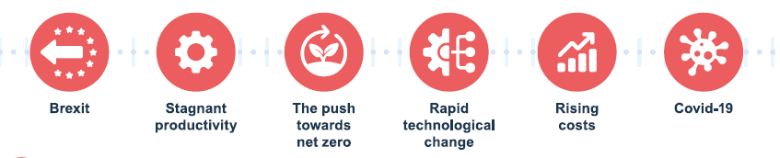
What’s the context?
SMEs are often seen as the backbone of the economy: there were 5.5 million businesses in the UK in 2024
  99.8 per cent of these were classified as SMEs
  99.2 per cent were small firms (0 to 49 employees)
The UK has traditionally had a strong entrepreneurial culture, with comparatively good start-up rates
But, ERC analysis has shown that many start-ups do not survive over the longer term, and that only a small proportion of firms reach significant business growth milestones
And, small businesses have faced some significant pressures over recent years, including:

Slide 4
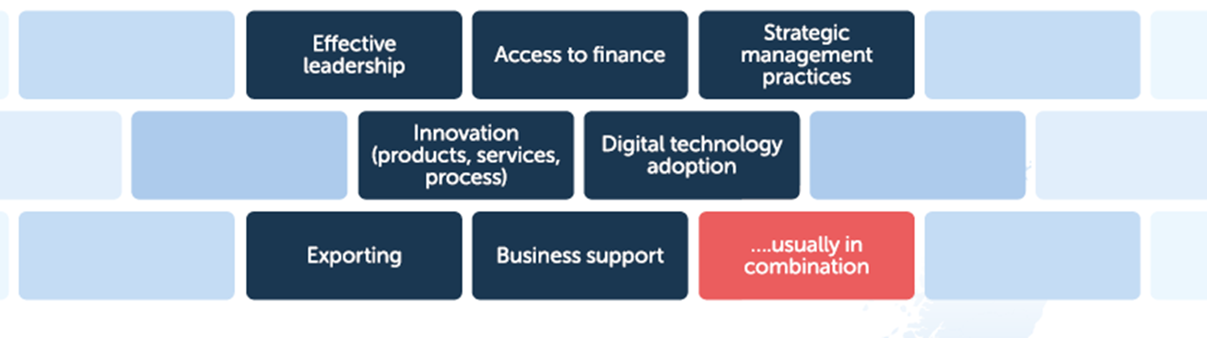
What promotes sustained growth in small businesses?
ERC research has shown that small business growth is multi-faceted and complex – and also episodic
But we know a range of key factors are important in enabling growth episodes, including:
What does our latest research tell us about the health of small businesses in the UK? And what are the implications for policy?

Slide 5
Business context
The past few years have been extremely challenging ones for SMEs, and 2024 saw this continue, with economic uncertainty continuing to impact firm behaviour
Global Entrepreneurship Survey findings show the UK is significantly more entrepreneurial now than 25 years ago:
  30% of working-age individuals intend to start a business within the next 3 years/ were trying to start/already running a business
The pandemic prompted a rise in early-stage entrepreneurial activity
But a substantial proportion of this is ‘necessity’ entrepreneurship
Business Insights and Conditions Survey data shows marked changes in business concerns in 2024:
  Falling demand for goods and services, increased competition and taxation were all higher up the agenda
  Inflation, energy prices and interest rates became less important concerns
  Focusing specifically on business turnover, SMEs most concerned about the cost of labour and materials, wider economic uncertainty, and increased competition

Slide 6
SME growth
A lack of sustained growth amongst SMEs in the UK remains a key problem for policymakers
Business growth has become more rare over time
  There are 400,000 more established SMEs (3 years +) since 2010, but the proportion registering ANY employment growth fell from 20% to 13%
Most small businesses do not survive, never mind grow
  Of the 325,811 start-ups registered in 2020, only 47% survived to 2023. The 10-year survival rates for start-ups is 10%
Only a small proportion of firms scale up
  Only 2% (3,049) of the surviving start-ups registered in 2020 managed to achieve £1m turnover after three years
A very small number of firms take a ‘step up’
  Only 7% of firms reaching over £1m turnover had over £3m by 2023
Most firms struggle to significantly increase turnover, jobs and productivity simultaneously
  Just under 10% of all firms that had increased their productivity did this between 2020-23
A range of factors affect business investment decisions
  Financial health, human capital, management practices and attitudes

Slide 7
The SME ecosystem
The UK has some clear and persistent weaknesses in its ecosystem that urgently need to be addressed
The UK has seen its overall entrepreneurial environment slip from being rated a ‘sufficient’ to ‘less than sufficient’ (GEM Survey)
The ratings for entrepreneurial finance (finance provision and ease of access to finance) have fallen over the last three years
Seeking external finance is positively associated with faster growth and productivity in small firms, but most are permanent ‘non-borrowers’
There has been a shift in the willingness of small firms to seek finance. Reasons include inadequate information, fear of rejection, lack of focus on growth
Research on equity finance amongst UK early-stage ventures published in 2024 shows that the journey to accessing equity finance is often long and difficult
  1/3 of the firms surveyed had sought equity finance in 2022-23, but only half of these were receiving any finance
  The average amount of their finance was only 2/5 of what they’d applied for
  Firms had typically made multiple (five or more) applications

Slide 8
The SME ecosystem
(continued)
There has also been a weakening in other areas of the ecosystem, including business support and physical infrastructure
The UK’s current business support system is fragmented and unstable
Nevertheless, business support plays an important role in business survival and growth, and is important for diffusing good practice
Uptake of support varies by range of factors, and there is a recognised lack of tailored support for disadvantaged/under-represented groups
Many firms first seek advice when they are already at the point of crisis – and that’s too late
The Longitudinal Small Business Survey panel report shows that there has been an increase in the proportion of SMEs using business support in recent years - 24% in 2020 to 27% in 2023
New LSBS analysis also shows the positive impact of business support on productivity. Firms that used external advice saw an average increase in their labour productivity by 22%

Slide 9
Innovation
Recent years have seen a worrying decline in innovation, particularly amongst smaller businesses
Innovation is closely linked to business survival, growth and productivity
The UK Innovation Survey (UKIS) shows a sharp decrease in innovation in recent years
  36% of firms were innovating in 2020-2022 compared to 45% in 2018-2020
  Large businesses are much more likely to be innovation active than smaller ones
    In 2020-2022, the UKIS found that 50% of large businesses were innovation active, compared to just 36% of SMEs
The ERC’s 2024 Innovation State of the Nation Survey (ISNS) also found evidence of declining innovation
  56% of businesses reported making product or service changes over the last year, falling from 61 per cent in 2023
The after-effects of the pandemic and the cost of doing business crisis were the most commonly cited barriers to innovation

Slide 10
Innovation
(continued)
Digital adoption is linked to performance benefits in SMEs
  ERC research shows that digitalised SMEs were also better equipped to deal with pandemic challenges
ERC research shows that the level of ‘digital readiness’ is key to adoption
New analysis of the LSBS reveals disparities in the adoption of specific digital technologies amongst SMEs
  Artificial Intelligence (AI), robotics, automation, and VR/AR technologies are less frequently adopted than others like accountancy software
  There are also differences in technology adoption by gender and location
Other new research highlights the tensions small business leaders face when adopting net zero practices (e.g., between sustainability and business goals)
  These can lead to firms becoming stuck in a ‘cycle of inaction’
Only a minority of small firms are currently receiving support with net zero adoption

Slide 11
Management and leadership
There is room for improvement in the adoption of management practices and strategic approaches to mental health and wellbeing
ERC research shows the link between business growth and management and leadership
High growth firms are more likely to use bundles of High Performance Working Practices and these practices are strongly associated with higher levels of innovation activity
Our longitudinal research on workplace mental health shows this is presenting significant issues for businesses. There has been a growth in long-term mental health related sickness absence and presenteeism
There is an ‘attitude to action’ gap in workplace mental health
  20% more firms say they believe that they should address mental health than are actually taking action
  Smaller firms are less likely to take action
Changing working practices (e.g. remote working) have brought new challenges for businesses
  72% of businesses believe that employees working from home are happier, but 53% cent said that it made teamworking more difficult

Slide 12
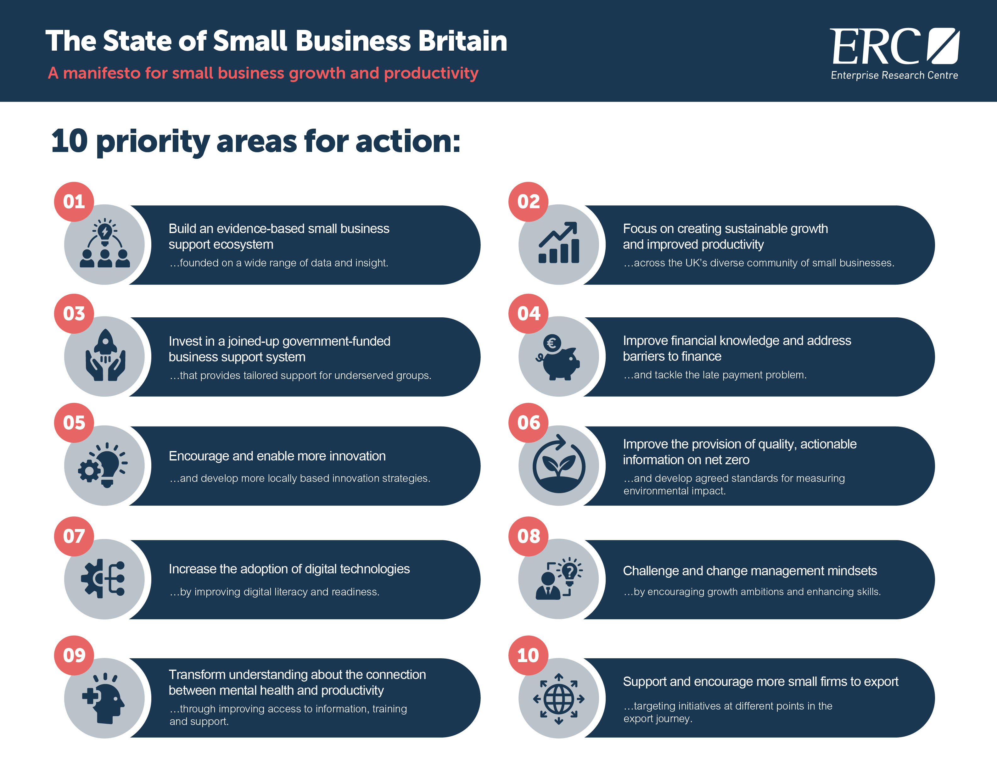

Slide 13




Slide 14
THANK YOU!
For further information about the ERC please visit us at:
www.enterpriseresearch.ac.uk

